Slide 1
CHAPTER CREDIT ANALYSIS
Explain the importance of liquidity, and describe working capital measures of liquidity and their components
Interpret the current ratio and cash-based measures of liquidity
Illustrate What-if analysis for evaluating changes in company conditions and policies
Describe capital structure and its relation to solvency
Explain financial leverage and its implications for company performance and analysis
Describe analysis tools for evaluating and interpreting capital structure composition and for assessing solvency.
Analyze asset composition and coverage for solvency analysis
Explain earnings-coverage analysis and its relevance in evaluating solvency

Slide 2
CREDIT ANALYSIS
LIQUIDITY
CAPITAL STRUCTURE AND SOLVENCY

Slide 3
Liquidity and Working Capital
• Liquidity
Ability to convert assets into cash or to obtain cash to meet short-term obligations.
Working Capital - The excess of current assets over current liabilities.
Repercussions:
Prevent from taking advantage of discounts or profitable opportunities.
Sale of investment
Insolvency and bankruptcy
A loss of owner control
A loss of capital investment
A delay in collecting obligations

Slide 4
Liquidity and Working Capital
Current Assets - Cash and other assets reasonably expected to be (1) realized in cash, or (2) sold or consumed, with in one-year or the normal operating cycle.
Current liabilities - Obligations to be satisfied within a relatively short period, usually a year.
Working Capital - Excess of current assets over current liabilities
Widely used measure of short-term liquidity
Basics

Slide 5
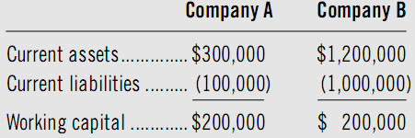

Slide 6
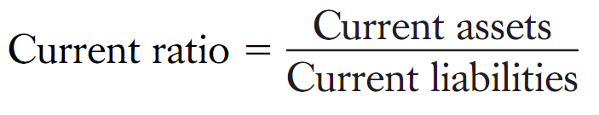
Current Ratio Measure of Liquidity
Current Ratio
– Ratio of Current Assets to Current Liabilities
– Relevant measure of current liability coverage, buffer against losses, reserve of liquid funds.

Slide 7
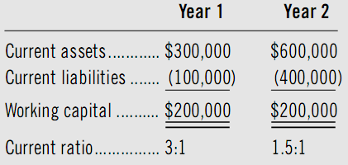
Current Ratio – Applications Trend analysis

Slide 8
Current Ratio – Applications Trend analysis
During a recession -> an increase in the current ratio
During a successful period -> an decrease in the current ratio
Prosperity squeeze?

Slide 9
Current Ratio – Applications Rule of Thumb Analysis
Current ratio above 2:1 - superior coverage of current liabilities (but not too high - inefficient resource use and reduced returns)
Current ratio below 2:1 - deficient coverage of current liabilities
Note of caution
Quality of current assets and the composition of current liabilities are more important in evaluating the current ratio.
Working capital requirements vary with industry conditions and the length of a company’s net trade cycle.

Slide 10
Liquidity Measures
Cash-based ratio measures
Accounts receivable liquidity measures
Inventory turnover measures
Accounts payable liquidity measures
Net trade cycle
Current assets composition
Acid-Test ratio
Cash flow measures
What-if analysis

Slide 11
Cash-Based Ratio Measures of Liquidity
Cash to Current Assets Ratio
Cash to Current Liabilities Ratio
Cash + Cash equivalents + Marketable Securities Current Assets
Cash + Cash equivalents + Marketable Securities Current Liabilities

Slide 12



Accounts Receivable Liquidity Measures
Accounts Receivable Turnover
Days’ Sales in Receivables
Receivables collection period
Credit sales vs net sales
Computing average A.R.
Monthly and quarterly figures
Sales fluctuate
How often, on average, receivables revolve
The terms of trade
The number of days it takes, on average, to collect accounts receivable- based on the year-end balance.

Slide 13
Accounts Receivable Liquidity Measures
Accounts receivable liquidity Measures are usefully compared with industry averages or with the credit terms given by the company
If usual credit terms of sales are 40 days, then what does a computed average collection period of 75 days reflect?
Poor collection efforts
Delays in customer payments
Customers in financial distress.

Slide 14



Inventory Liquidity Measures
Inventory turnover ratio:
Days’ Sales in Inventory:
Days to sell inventory:
Conversion period (operating cycle):
Receivables collection period + days to sell inventory
The average speed at which inventories move through and out of a company
Cost of goods sold in place of sales
Average inventory – quarterly, monthly
The number of days required to sell ending inventory assuming a given rate of sales
The number of days required to sell average inventory for the period

Slide 15
Liquidity of Current Liabilities
Current liabilities are important in computing working capital and current ratio:
Used in determining whether sufficient margin of safety exists.
Deducted from current assets in arriving at working capital.

Slide 16


Days’ Purchases in Accounts Payable
Accounts Payable Turnover
Days’ Purchases in Accounts Payable
(The average payable days of outstanding )
The speed at which a company pays for purchases on account
Purchases can be substituted for cost of goods sold
The average time based on the year-end balance in accounts payable that the company takes in paying its obligations to suppliers
The longer, the greater

Slide 17
Net Trade Cycle Analysis

Slide 18
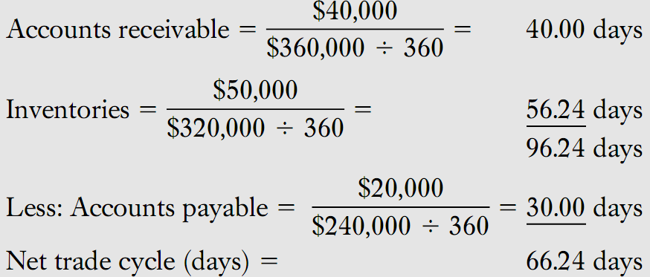
Net Trade Cycle Analysis

Slide 19
Additional Liquidity Measures
Current Assets composition
Acid-test (Quick) Ratio
Cash Flow Ratio
What-If Analysis

Slide 20
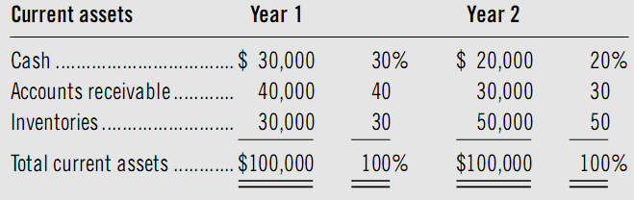
Current Assets Composition
The composition of current assets is an indicator of working capital liquidity – common-size percentage comparison
A marked deterioration in current asset liquidity in Year 2 relative to Year 1. This is evidenced by a 10% decline for both cash and accounts receivable

Slide 21

Acid-Test (Quick) Ratio
Cash Flow Ratio

Slide 22
What-if analysis
Background Data—The company ABC at December 31, Year 1:
Cash $ 70,000
Accounts receivable 150,000
Inventory 65,000
Accounts payable 130,000
Notes payable 35,000
Accrued taxes 18,000
Fixed assets 200,000
Accumulated depreciation 43,000
Capital stock 200,000
The following additional information is reported for Year 1:
Sales $750,000
Cost of sales 520,000
Purchases 350,000
Depreciation 25,000
Net income 20,000
Anticipates 10 percent growth in sales for Year 2
All revenue and expense items are expected to increase by 10 percent, except for depreciation, which remains the same
All expenses are paid in cash as they are incurred
Year 2 ending inventory is projected at $150,000
By the end of Year 2, predicts notes payable of $50,000 and a zero balance in accrued taxes
Maintains a minimum cash balance of $50,000

Slide 23
Case 1: The company ABC is considering a change in credit policy where ending accounts receivable reflect 90 days of sales. What impact does this change have on the company’s cash balance? Will this change affect the company’s need to borrow?
Our analysis of this what-if situation is as follows:
Cash, January 1, Year 2
Cash collections:
Accounts receivable, January 1, Year 2
Sales
Total potential cash collections
Less: Accounts receivable, December 31, Year 2
Total cash available
Cash disbursements:
Accounts payable, January 1, Year 2
Purchases
Total potential cash disbursements
Accounts payable, December 31, Year 2
Notes payable, January 1, Year 2
Notes payable, December 31, Year 2
Accrued taxes
Cash expenses(d)
Cash, December 31, Year 2
Cash balance desired
Cash excess

Slide 24
Case 2: What if the company ABC worked to achieve an average accounts receivable turnover of 4.0 (instead of using ending receivables as in the previous case). What impact does this change have on the company’s cash balance? Will this change affect the company’s need to borrow?
Our analysis of this what-if situation is as follows:
Cash, January 1, Year 2
Cash collections:
Accounts receivable, January 1, Year 2
Sales
Total potential cash collections
Less: Accounts receivable, December 31, Year 2
Total cash available
Cash disbursements:
Accounts payable, January 1, Year 2
Purchases
Total potential cash disbursements
Accounts payable, December 31, Year 2
Notes payable, January 1, Year 2
Notes payable, December 31, Year 2
Accrued taxes
Cash expenses(d)
Cash, December 31, Year 2
Cash balance desired
Cash excess

Slide 25
Case 3: What if, in addition to the conditions prevailing in case 2, the company’s suppiers require payment within 60 days? What impact does this change have on the company’s cash balance? Will this change affect the company’s need to borrow?
Our analysis of this what-if situation is as follows:
Cash, January 1, Year 2
Cash collections:
Accounts receivable, January 1, Year 2
Sales
Total potential cash collections
Less: Accounts receivable, December 31, Year 2
Total cash available
Cash disbursements:
Accounts payable, January 1, Year 2
Purchases
Total potential cash disbursements
Accounts payable, December 31, Year 2
Notes payable, January 1, Year 2
Notes payable, December 31, Year 2
Accrued taxes
Cash expenses(d)
Cash, December 31, Year 2
Cash balance desired
Cash excess

Slide 26
Basics of Solvency
Capital structure — financing sources and their attributes
Earning power — recurring ability to generate cash from operations
Loan covenants — protection against insolvency and financial distress; they define default (and the legal remedies available when it occurs) to allow the opportunity to collect on a loan before severe distress

Slide 27
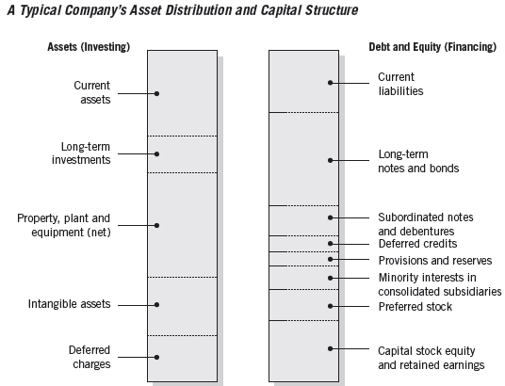
Capital Structure
Equity financing
A company’s stability and solvency
A degree of permanence, persistence in times of adversities
A lack of any mandatory dividend requirement
Debt financing
Must be repaid
Failure to pay principal and interest typically results in legal proceedings
The company should be only financed by equity. Do you agree?

Slide 28
Financial Leverage
Financial leverage - the amount of debt financing in a company’s capital structure.
Companies with financial leverage are said to be trading on the equity.

Slide 29
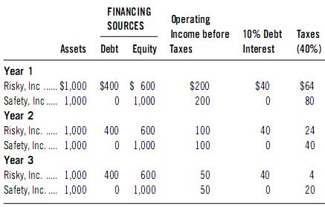
The Effects of Financial Leverage

Slide 30
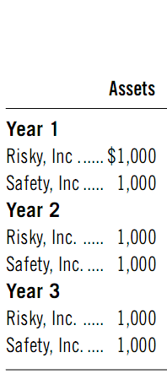
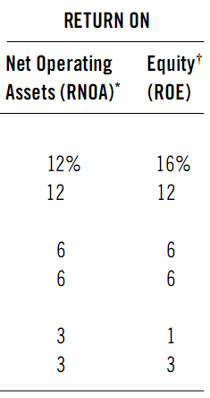
The Effects of Financial Leverage

Slide 31
The Effects of Financial Leverage
A levered company is successfully trading on the equity when return on assets exceeds the after-tax cost of debt.
A levered company is unsuccessfully trading on the equity when return on assets is less than the after-tax cost of debt.
The effects of leveraging are magnified in both good and bad years.

Slide 32
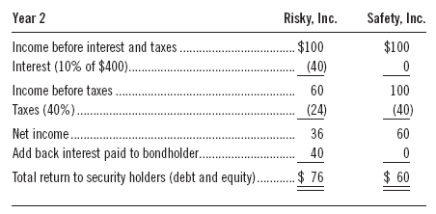
Tax Deductibility of Interest

Slide 33
Tax Deductibility of Interest
Interest is tax deductible while cash dividends to equity holders are not
The income available to security holders can be much larger
Nonpayment of interest can yield bankruptcy whereas nonpayment of dividends does not

Slide 34
Motivation for Debt
Financial leverage
Tax Deductibility of Interest

Slide 35
Capital Structure Composition and Solvency
Common-Size Statements
Total Debt to Total Capital
Total Debt to Equity Capital
Long-Term Debt to Equity Capital
Short-Term Debt to Total Capital
Asset Composition

Slide 36
Common-Size Statements in Solvency Analysis
Composition analysis
Performed by constructing a common-size statement of the liabilities and equity section of the balance sheet.
Reveals relative magnitude of financing sources.

Slide 37
Capital Structure Ratios
Total Debt to Total Capital Ratio
Comprehensive measure of the relation between total debt and total capital
Also called Total debt ratio
Total Debt to Equity Capital
Long-Term Debt to Equity Capital
Measures the relation of LT debt to equity capital.
Commonly referred to as the debt to equity ratio.
Short-Term Debt to Total Debt
Indicator of enterprise reliance on short-term financing.
Usually subject to frequent changes in interest rates.

Slide 38

Earnings Coverage
Considers interest as the only fixed charge needing earnings coverage:
Numerator sometimes referred to as earnings before interest and taxes, or EBIT.
Times Interest Earned

Slide 39

LIQUIDITY | CAPITAL STRUCTURE AND SOLVENCY
Cash-based ratio measures Accounts receivable liquidity measures Inventory turnover measures Accounts payable liquidity measures Net trade cycle Current assets composition Acid-Test ratio Cash flow measures What-if analysis | Common-Size Statements Total Debt to Total Capital Total Debt to Equity Capital Long-Term Debt to Equity Capital Short-Term Debt to Total Capital Asset Composition

